Slide 1
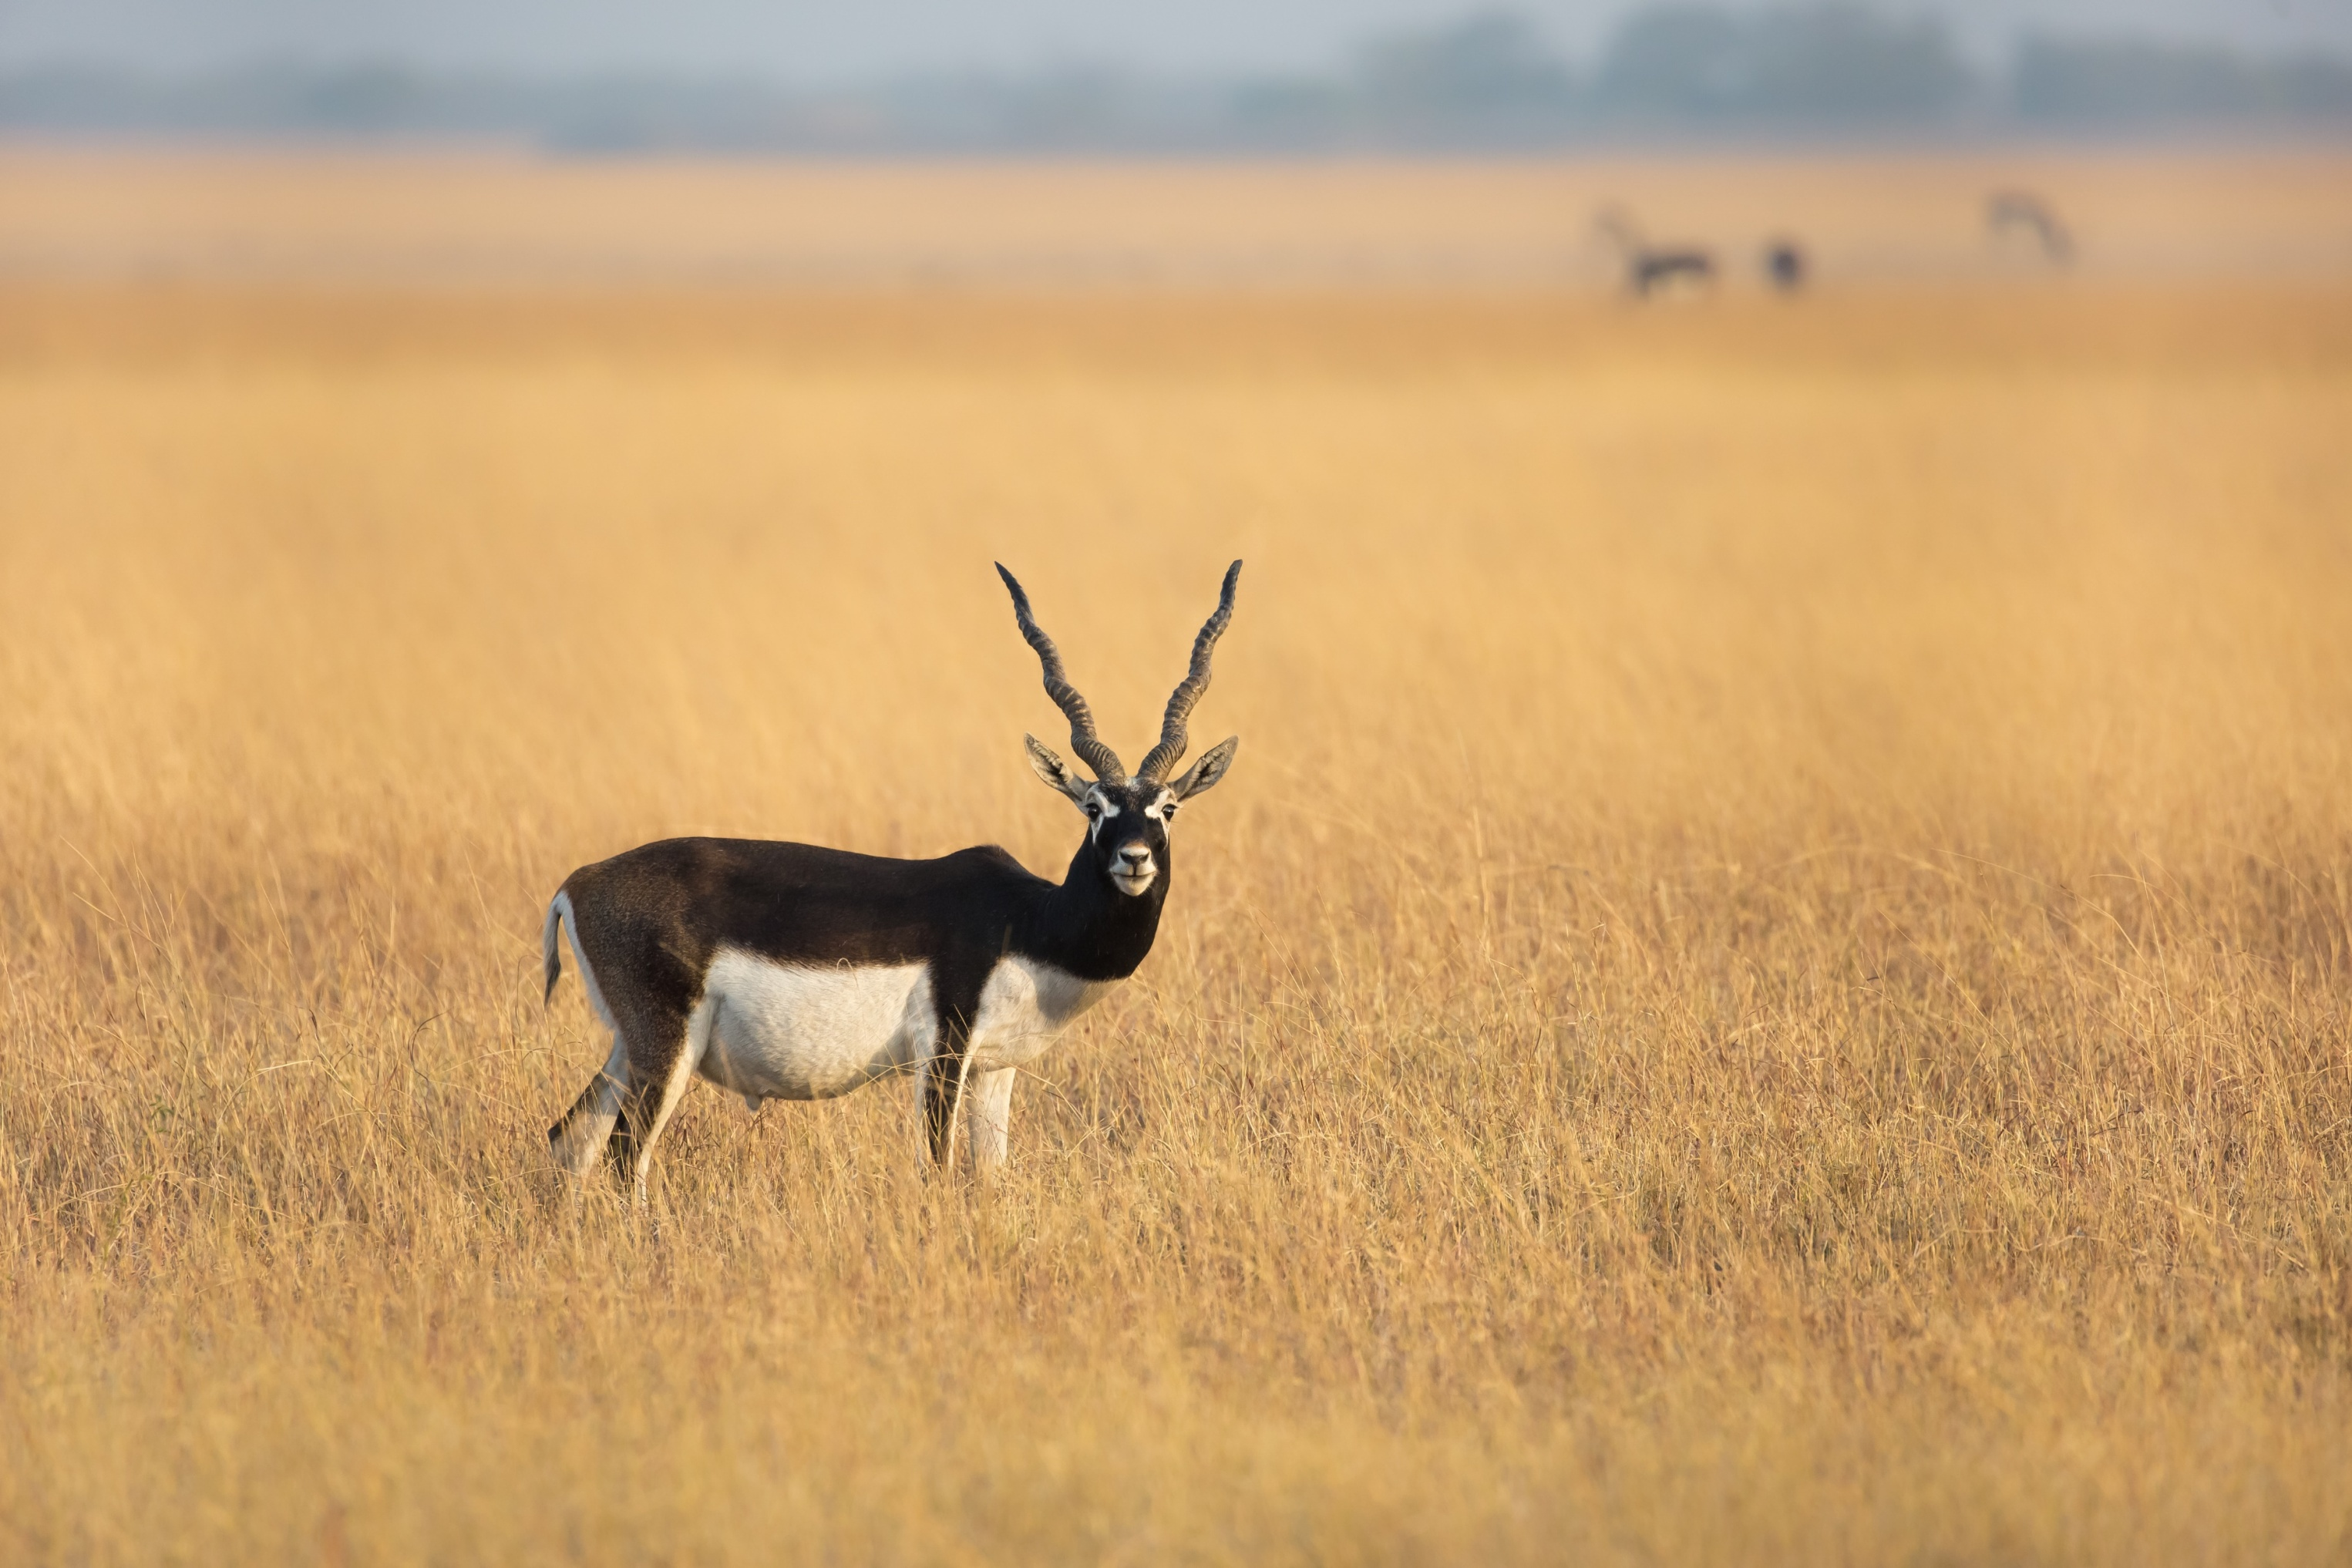
Development of Ecotourism
Ministry of Environment Forest and Climate Change

Slide 2
Content
Guidelines On Sustainable Eco-tourism in Forest And Wildlife Areas 2021
Amrit Dharohar Scheme
Possible Ways Of Convergence

Slide 3
Objectives
Adopting low impact nature tourism
Promoting biodiversity richness, traditional ecological knowledge and heritage values of India’s wilderness
Engaging local communities
Establishing partnerships
Enhancing potential of India as a global eco-tourism destination

Slide 4
Guiding Principles
Eco-tourism Plan - science based
Eco-tourism zone - upon assessment of management requirement
Community participation-equitable benefits flow
Eco-tourism site development – Maintenance of natural profile and ecological integrity
Inter-sectoral synergy – Streamlining of regulations and procedures
Promoting eco-tourism entrepreneurship – focus of increasing productivity and skill development

Slide 5
Implementation strategy
Identification of potential sites
– Participatory process and carrying capacity analysis
Funding support
– Compatible financial instruments
Usage of Information Technology
- social media engagement, newsletter, booking, media and marketing etc.
Capacity building
- field functionaries, the eco-tourism site managers and the local communities
Sharing of revenue benefits
- local eco-development committees / forest protection committees
Education and outreach
- electronic visual tools and well equipped modern interpretation centre
Monitoring
- to monitor stress on wildlife vis-a-vis number and patterns of tourist visitation and their level of satisfaction, involvement of local people, scope for improvement in flow of eco-system services, etc
Review – Every three years

Slide 6
GUIDELINES FOR TOURISM IN AND AROUND TIGER RESERVES - 2012
No new tourist infrastructure shall be set up within the core or critical tiger habitat of tiger reserves
To ensure that gate receipts from tiger reserves are utilised by their management for specific conservation purposes and shall not to go as revenue to the State Exchequer.
A Local Advisory Committee shall be constituted for each tiger reserve by the State Government.
A tourism plan, as part of the Tiger Conservation Plan
All tourism activities shall take place only in delineated 'tourism zones‘ indicated in the tourism plan
Estimation of carrying capacity

Slide 7
Convergence
Tourism master plan
Connectivity
Solid waste management, washroom
Souvenir, Interpretation centre , Zoos
Capacity building of locals eg Keoladeo National park
Wide Publicity
Tourism circuits

Slide 8
Amrit Dharohar
Introduced in the budget speech of February 01, 2023
To be implemented over the next three years to support the development of nature-based tourism at the Ramsar Sites to achieve wise use commitments.
Scheme emphasis:
Enabling integrated management to ensure sustained provision of the full range of ecosystem services
Encouraging optimal use while ensuring the maintenance of wetland ecological character
safeguarding and enhancing biological diversity and carbon stock
protecting and promoting cultural heritage values
creating nature tourism opportunities and income generation for local communities

Slide 9
Ramsar sites of India
Designated 75 wetlands spanning 1.32 million ha (~ 8% of known wetland regime) as Wetlands of International Importance under Ramsar Convention

Slide 10
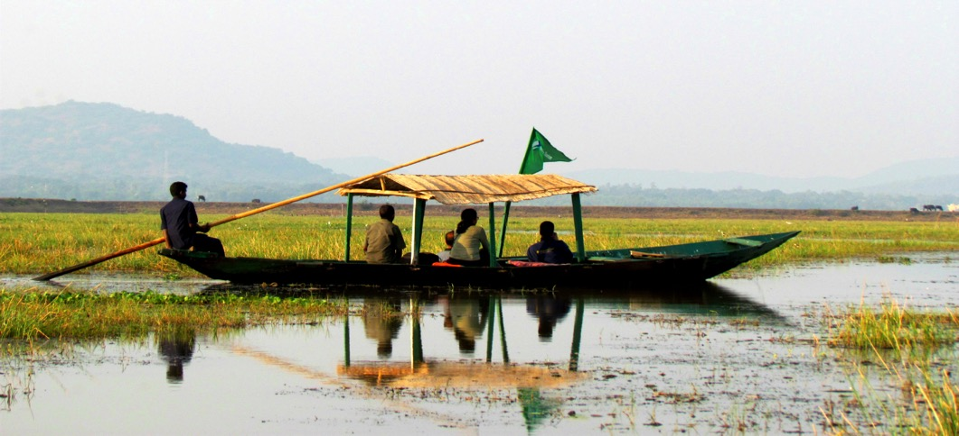
Model of sustainable wetland tourism
Manglajodi village is the foremost site of nature-based tourism in Chilika, Ramsar Site in Odisha
Manglajodi now hosts more than 300,000 birds. The wetland receives over 50,000 tourists annually, providing livelihoods to 150 families.

Slide 11
Guiding Principles
Nature tourism -biodiversity, socio-cultural, heritage and recreational dimensions of wetlands
High-volume tourism to high-value nature tourism
Tourism aligned with wetland wise-use within the framework of Wetlands (Conservation and Management) Rules, 2017
Wider circuit Development
Wetland interpretation centre
Heritage villages showcase socio-cultural and heritage dimensions of wetlands conservation
At least one product each wetland as a souvenir

Slide 12
Shortlisted sites
Based on cultural and other values
Sl. No. | Names | State | Date of Designation
1 | Khijadiya | Gujarat | 2-2-2022
2 | Deepor beel | Assam | 19-08-2022
3 | Renuka | Himachal Pradesh | 08-11-2005
4 | Pong Dam Lake | Himachal Pradesh | 19-08-2002
5 | Vembanad-Kol | Kerala | 19-08-2002
6 | Loktak | Manipur | 23-03-1990
7 | Bhitarkanika Mangrove | Odisha | 19-08-2002
8 | Chilika Lake | Odisha | 01-10-1981
9 | Keshopur-Miami | Punjab | 26-09-2019
10 | Vedanthangal | Tamil Nadu | 08-04-2022
11 | Sunderbans | West Bengal | 30-01-2019

Slide 13
Selection of Potential Sites
Sites shall be selected in phased manner based on following criteria:
High cultural significance
Connectivity
Common to the tourism destination shortlisted by Ministry of Tourism
Proximity to other tourism sites/ part of wider tourism circuit
Availability of interpretation centre
Availability of basic amenities at site
Availability of good boarding & lodging facilities

Slide 14
Convergence solicited
Wetlands Interpretation Centres
Access infrastructure to the Ramsar Sites
Tourist amenities
Development of amenities at heritage villages
Perspective tourism development plans for Ramsar Sites
Capacity development programmes
Linking wetland to Tourism circuit
Wider publicity ( through advertisements at airports and railway stations, and other material).

Slide 15
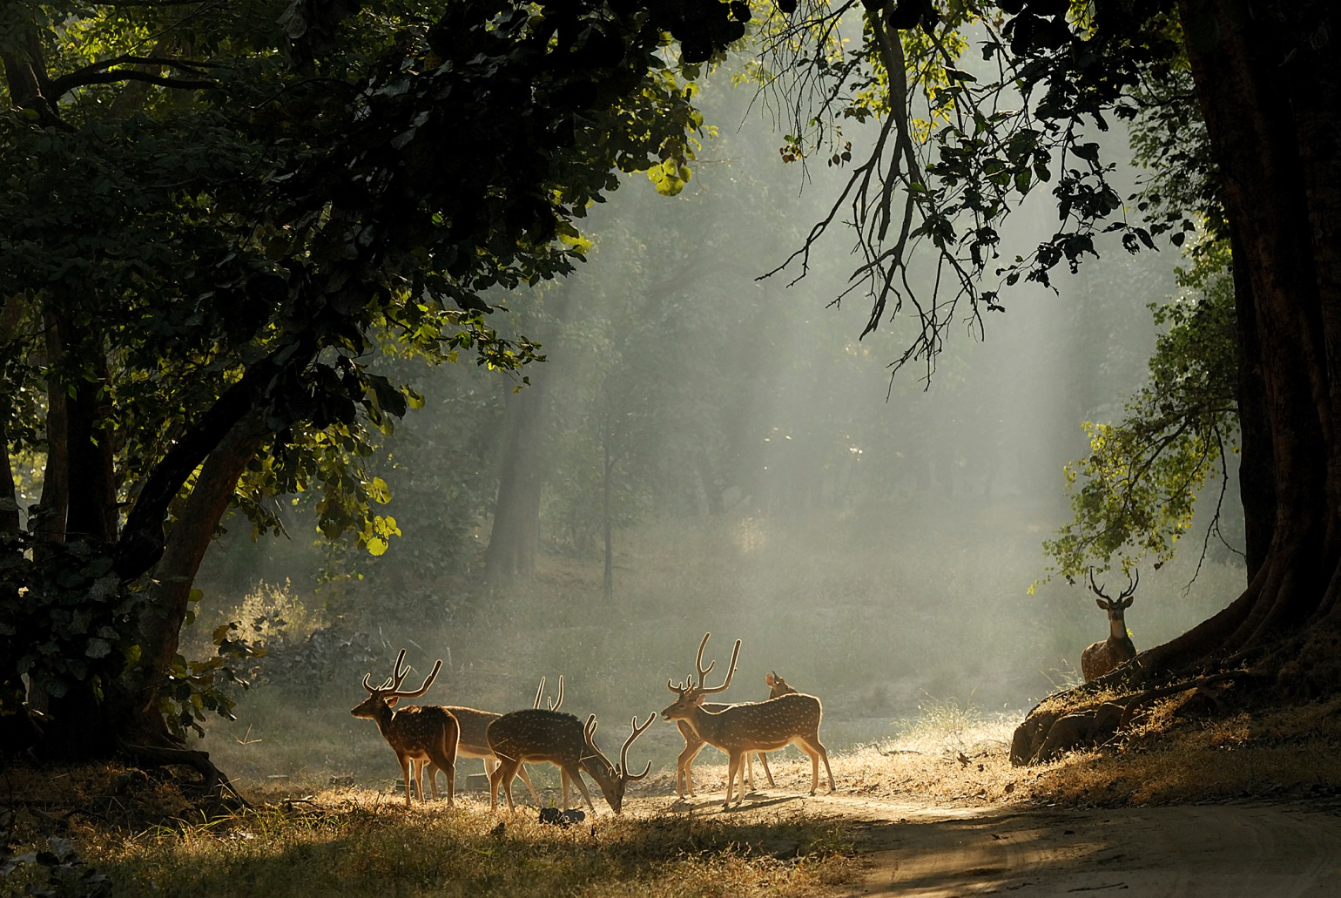
Thank you

